Slide 1
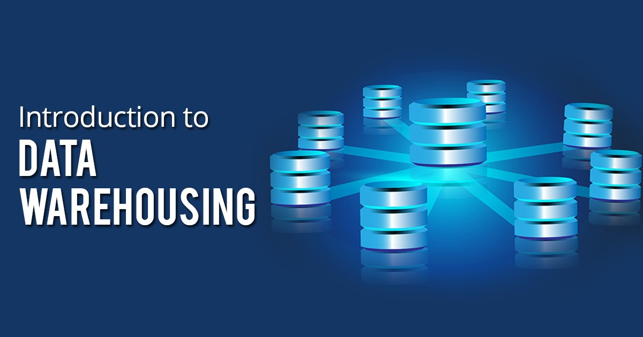

Slide 2


Slide 3


Slide 4

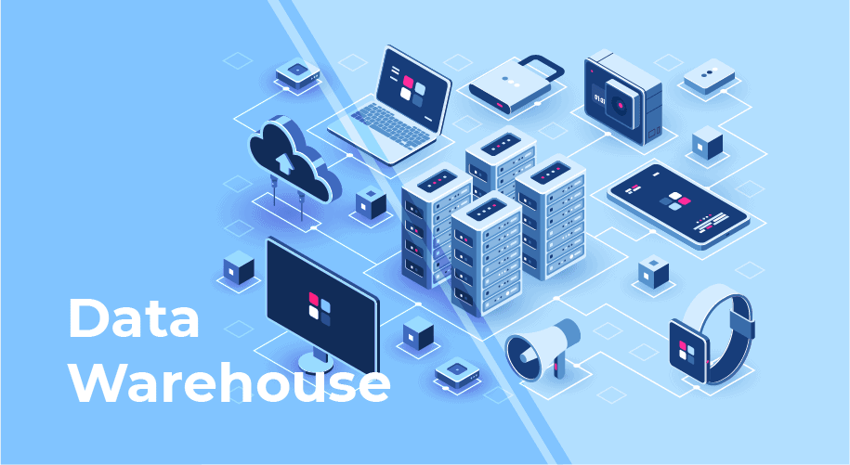
Data Warehousing is the central component of the business intelligence system which is responsible for storing , collecting, managing data from different heterogeneous sources in order to analyze the data for business decisions.

Slide 5
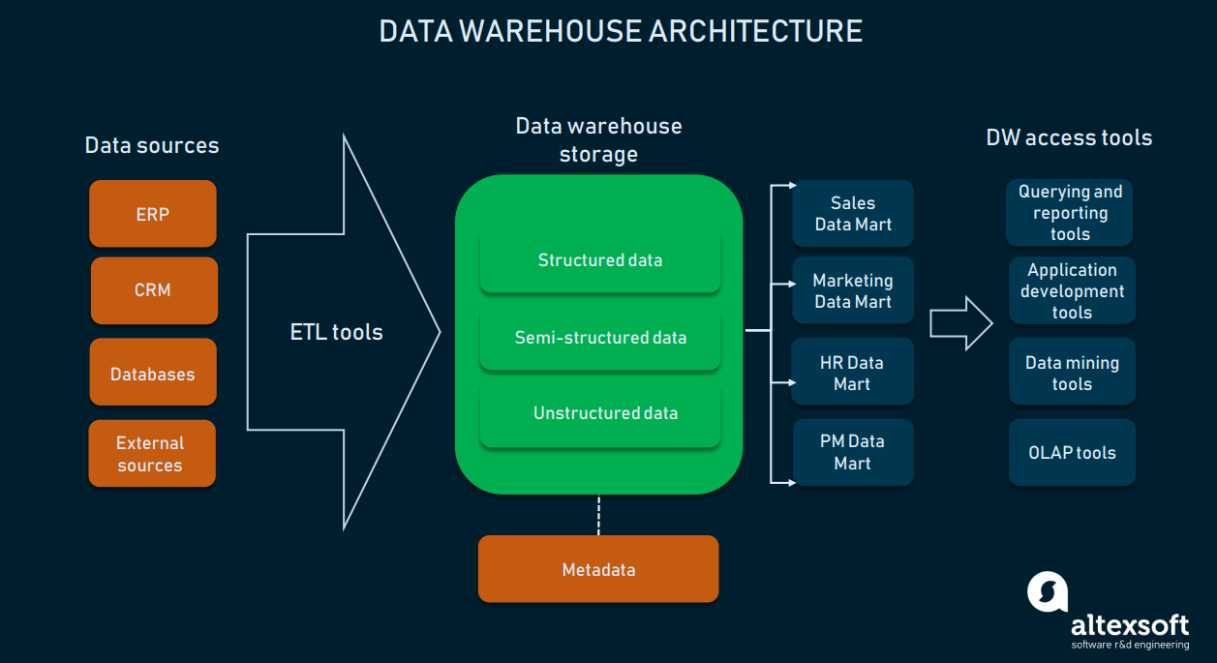
META DATA
SUMMARY DATA
RAW DATA

Slide 6
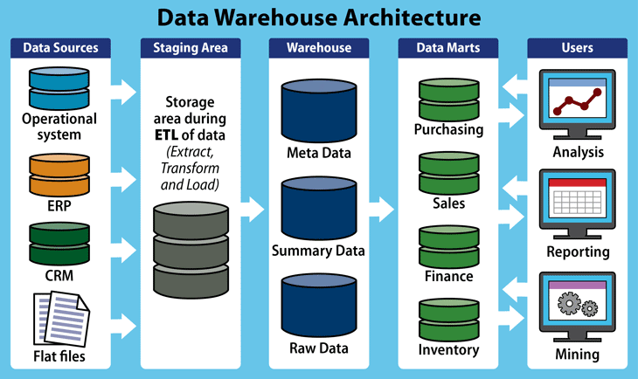

Slide 7
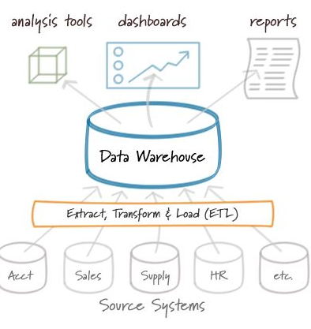

Slide 8
Difference between database and datawarehouse:
DATABASE:
DATAWAREHOUSE:
Online transaction processing
Application oriented.
Clerical users(it professionals)DBA.
Isolated data.
Oltp is used for to run the business.
Updated data.
Small amount of data used in this process.
Day-to-day operations.
FOCUSSED on “information in”
DATABASE design by using ER-MODEL.
Online analytical processing
Subject oriented.
Used by managerial users(dataanalyst).
Integrated data.
Olap is used to analyze the data for business.
Retrival data.
Large amount of data used in this process.
3,6,12 transactions.
FOCUSSED on “information out”.
DATAWAREHOUSE design by using schemas

Slide 9
DATABASE:
DATAWAREHOUSE
Transaction purpose.
Records are accessed among tens of data.
Detailed and flat relational view of data.
Primitive and detailed data.
Size is more than 1 -100gb.
Performance is high.
It contains flexible structure.
Tables,insert,update,delete,modify and read only data.
Sql,plsql
Decision making.
Records are accessed among millions of data.
Multidimensional view of data.
Summarized data.
Size is more than 100gb.
Flexibilty is high.
It contains static structure.
Rolldown(or)drilldown,slice,dice,pivote table or rotate.
Dmql,datamining tools.

Slide 10
DATA WAREHOUSE :- Datawarehouse is multidimensional management system that is designed for analysis, reporting, querying and to support the decision making management system.
A Data warehouse is copy of transaction data specifically structured for for query & reporting.
Datawarehouse data contains current data, historical data, lightly, highly, summarized data and meta data.
Meta Data: meta data is “data about data” it is important for designing, constructing, retrieving and controlling data warehouse data.
Data mart :- contains a subset of data warehouse information or collection metadata information.
A Data WareHouse is a relational Database that is designed for query & reporting. It usally contains Historical data derived transaction data (or)
A data warehouse is constructed by integrating data from multiple heterogeneous sources that support analytical reporting, structured and/or ad hoc queries, and decision making

Slide 11
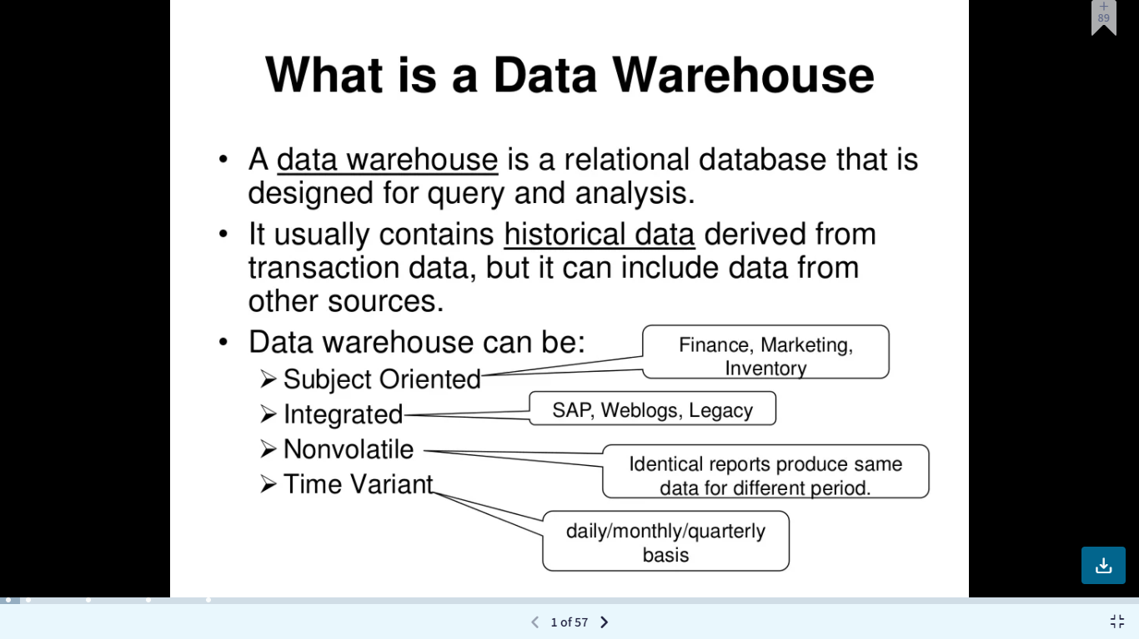

Slide 12
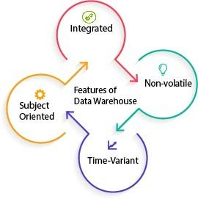

Slide 13
FEATURES OF DATAWAREHOUSE:
1.Subject oriented: A data warehouse is called subject-oriented as it shows the data based on the subject, not based on the ongoing operation.
For, instance data is assessed as financial data, marketing, HR etc.
ex: E-commerce: sales, customer, products.
2. Data Integration: Data in the data warehouse is constructed from the integration of data from various sources- relational databases, flat files, etc. which offers better data analysis.
As a result, data is well integrated which makes the analysing of data easy. Plus it helps the decision-maker to integrate, read and analyze the data from different sources.
3.Time variant: The data in a DWH gives information from a specific historical point of time; Datawarehouse contains previous data and current data.
in Datawarehouse data is retrived in quarterly, half yearly and yearly.
4.non-volatile: Once data is enter in to the Datawarehouse, it will not change ,so ,historical data in Datawarehouse should never be altered.
Data warehouse is also non-volatile means previous data is not erased when new data is entered in it.

Slide 14
Data Warehouse Architecture:
There are three ways you can construct a data warehouse system. These approaches are classified by the number of tiers in the architecture. Therefore, you can have a:
Single-tier architecture(basic data warehouse Architecture)
Two-tier data warehouse Architecture with staging area
Three-tier data warehouse Architecture with staging area and data marts.

Slide 15
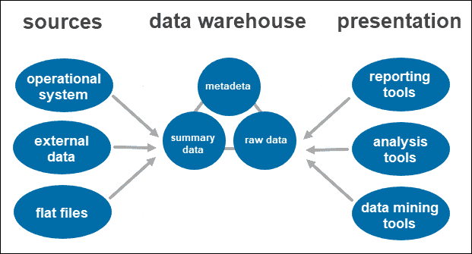
Single-tier Data Warehouse Architecture: It is a basic data warehouse Architecture . The single-tier architecture is not a frequently practiced approach. The main goal of having such an architecture is to remove redundancy by minimizing the amount of data stored.

Slide 16
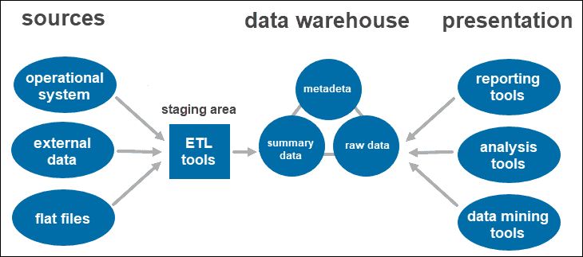
Two-tier Data Warehouse Architecture: Two-tier architecture includes A staging area for all data sources, before the data warehouse layer. By adding A staging area between the sources and the storage repository, you ensure all data loaded into the warehouse is cleansed and in the appropriate format.

Slide 17
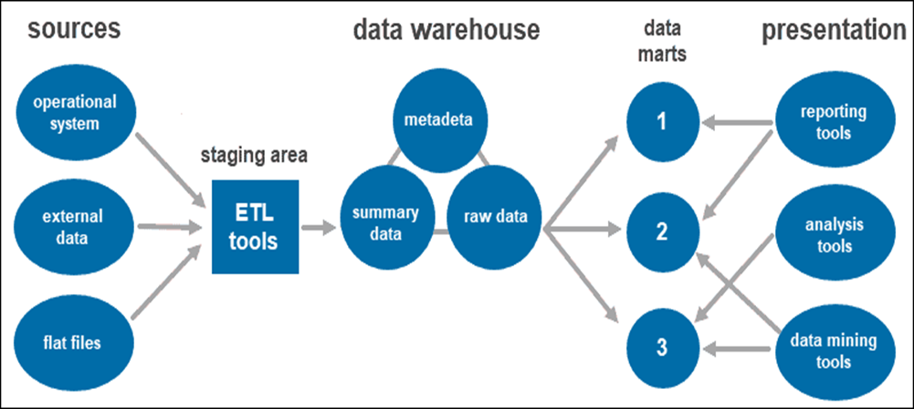
Three-tier data warehouse architecture: the three-tier approach is the most widely used architecture for data warehouse systems. Essentially, it consists of three tiers: the bottom tier is the database of the warehouse, where the cleansed and transformed data is loaded. The middle tier is the application layer giving an abstracted view of the database. It arranges the data to make it more suitable for analysis. This is done with an OLAP server, implemented using the ROLAP or MOLAP model. The top-tier is where the user accesses and interacts with the data. It represents the front-end client layer. You can use reporting tools, query, analysis or data mining tools.

Slide 18
Data Warehouse Components:
There are mainly 5 components of data warehouse architecture.
1.Database (source data).
2.ETL Tools.
3.Meta data,summerydata,raw data.
4. Data mart.
5.Query tools,reporting tools,datamining tools,

Slide 19
The Database (source data) The most crucial component and the heart of each architecture is the database. The warehouse is where the data is stored and accessed.
When creating the data warehouse system, you first need to decide what kind of database you want to use.
There are four types of databases you can choose from:
Relational databases (row-centered databases).
Operational systems: used to process the day to day transaction of organization.
Cloud-based databases (hosted on the cloud).
Flat files: flat files system is system of files in which transactional data is stored
And every files in the system must have different names.

Slide 20
ETL TOOLS:
Data Extraction - Involves gathering data from multiple heterogeneous sources. . Data Transformation - Involves converting the data from legacy format to warehouse format.
Data Loading - Involves sorting, summarizing, consolidating, checking integrity, and building indices and partitions.

Slide 21
Data in data warehouse :Once the system cleans and organizes the data, it stores it in the data warehouse. The data warehouse represents the central repository that stores metadata, summary data, and raw data coming from each source.
Metadata : Metadata is simply defined as data about data. The data that is used to represent other data is known as meta data. For example the index of book serves as meta data for the contents in the book. we can say that meta data is the summarized data that leads to the detailed data.
In data warehouse meta data defines the warehouse objects.
Meta data is road map to the data warehouse creations.
Meta data used for query tools,report tools and transformation tools.
Summary data is generated by the warehouse manager. It updates as new data loads into the warehouse. This component can include lightly or highly summarized data. Its main role is to speed up query performance.
Raw data is the actual data loading into the repository, which has not been processed. Having the data in its
raw form makes it accessible for further processing and analysis.

Slide 22
DATAMART:
Collection of meta data information is called datamart.
And also it contains subset of datawarehouse information.
It is a datastore which is designed for particular dept of organization.
Reason for creating datamart is easy access of frequent data ,improved end user response time. Easy creation data warehouse,less sw and hw cost and faster and cheaper to build.

Slide 23
End user-Access Tools: The main purpose of the data warehouse is to provide the information to the business manager for decision making.These customers interact with data warehouse using end client tools.
Some of the tools used include:
Reporting tools. They play a crucial role in understanding how your business is doing and what should be done next. Reporting tools include visualizations such as graphs and charts showing how data changes over time.
OLAP tools. Online analytical processing tools provide fast processing and valuable analysis. They extract data from numerous relational data sets and reorganize it into a multidimensional format.
Data mining tools. Examine data sets to find patterns within the warehouse and the correlation between them. Data mining also helps establish relationships when analyzing multidimensional data.

Slide 24

The field of data warehousing is most emerging and there various cloud data warehousing tools and technologies are developed for better decision making. The cloud-based data warehousing tools are fast, highly scalable, and available on a pay-per-use basis. Following are some data warehousing tools:
Amazon Redshift
Microsoft Azure
Google BigQuery
Snowflake
Micro Focus Vertica
Teradata
Amazon DynamoDB
PostgreSQL
Amazon RD
Amazon S3
All these are the top 10 Data Warehousing Tools.

Slide 25
The process of constructing DataWare House requires following things. Data Extraction - Involves gathering data from multiple heterogeneous sources. Data Cleaning - Involves finding and correcting the errors in data. Data Transformation - Involves converting the data from legacy format to warehouse format. Data Loading - Involves sorting, summarizing, consolidating, checking integrity, and building indices and partitions. Refreshing - Involves updating from data sources to warehouse.
Functions of Data Warehouse Tools and Utilities:

Slide 26
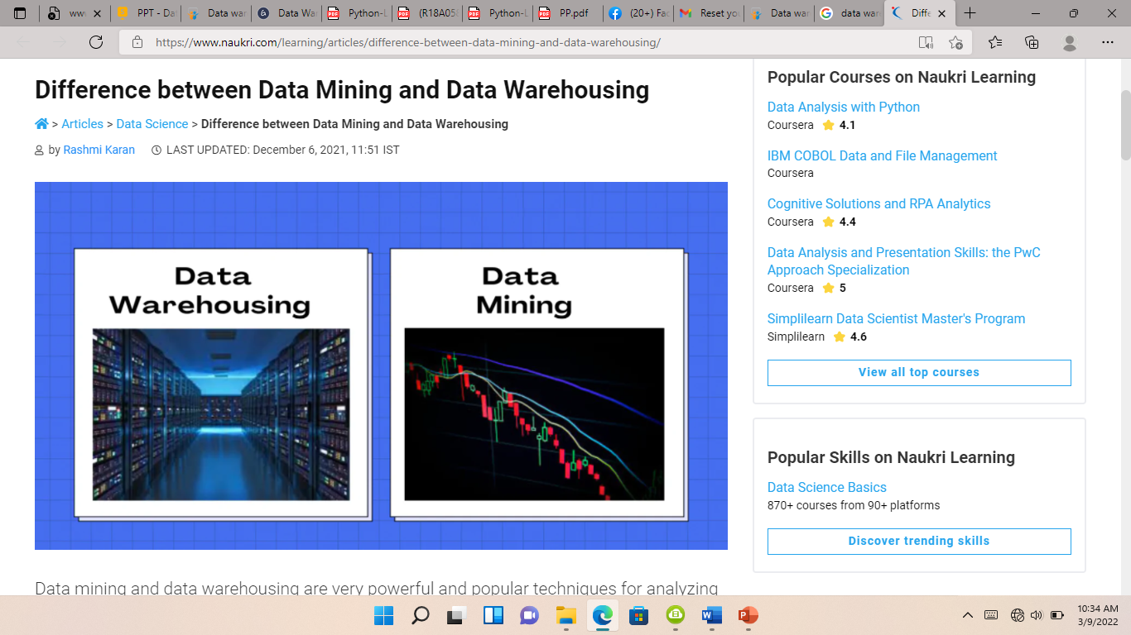

Slide 27
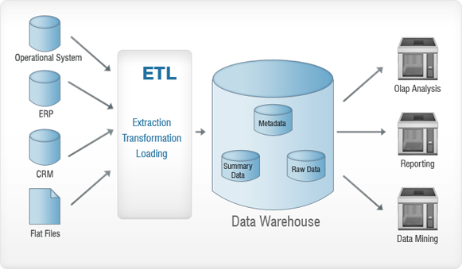
Note: Data cleaning and data transformation are important steps in improving the quality of data and data mining results. A great example of data warehousing that everyone can relate to is what Facebook does. Facebook basically gathers all of your data – your friends, your likes, who you stalk, etc – and then stores that data into one central repository. Business intelligence (BI) is the combination of software applications, methodologies and business systems that transform raw data into meaningful and useful information.

Slide 28
SNO | DATABASE | DATAWAREHOUSE
1 | APPLICATION ORIENTED | SUBJECT (WISE) ORIENTED
2 | DETAILED DATA | SUMMARIZED DATA
3 | IT CONTAINS PRESENT DATA,CURRENT DATA,UP TO DATE | IT CONTAINS HISTORICAL DATA,PREVIOUS DATA
4 | ISOLATED DATA | INTEGRATED DATA
5 | DATA STORED IN ROWS/COLUMNS(TABLES) | DATA STORED IN CUBES/DIMENSIONS
6 | 100 GB | 100GB to1,00,000 GB
7 | CLERICAL USERS (IT PROFESSIONALS) | MANAGERAL USERS(ANALYST)
8 | SQL | DMQL
9 | TRANSACTION PURPOSE | DECISION MAKING SUPPORT
10 | DAY TO DAY OPERATIONS | QUARTERLY,HALFREARLY,YEARLY TRANSACTION
11 | THOUSANDS OF USERS ARE WOKING | HUNDREDS OF USERS ARE WORKING
12 | SIMPLE TRANSACTIONS | COMPLEX TRANSACTIONS
13 | ENTITY RELATIONAL MODEL | MULTIDIMENSIONAL MODEL
14 | UPDATE THE DATA | RETRIVAL DATA
15 | SMALL AMOUNT OF DATA USED IN THIS PROCESS. | LARGE AMOUNT DATA USED IN THIS PROCESS
16 | IT CONTAINS FLEXIBLE STRUCTURE | IT CONTAINS STATIC STRUCTURE
17 | PERFORMANCE SENSIVITY | PERFORMANCE RELAXED
18 | IMMEDIATE DATA | PERIODIC DATA

Slide 29
** MULTI DIMENSIONAL DATABASE MODEL(OLAP)**
Multi dimentional data base management system designed to support of management decision making process & analysis.
A multidimensional database management system (MDDBMS) provides a multidimensional view of data. For instance, in multidimensional analysis, entities such as products, regions, customers and dates represent different dimensions.
A Data WAREHOUSE is based on a MULTIDIMENSIONAL DATA MODEL which views data in the form of a data cube
A Data cube allows data to be modeled and viewed in multiple dimensions
ON-LINE ANALYTICAL PROCESSING (OLAP) was proposed by E. F. Codd, the father of the relational DataBase.

Slide 30
Olap Provides Enterprise With ”Memory”.
Olap Provides The “Optimises” The Businesses.
Data Mining Provides Enterprises With “Intelligence”.
Oltp Systems Are Used Run The Businesses.
Strength Of Olap:
Olap Provides Good Visulization Paradigm.
It Provides Fast,Interactive Responsive Times.
It Id Good For Analysing And Time Series.
Creating a Multidimensional Array:
Two key steps in converting tabular data into a multidimensional array.
First, identify which attributes are to be the dimensions and which attribute is to be the target attribute whose values appear as entries in the multidimensional array.
Second, find the value of each entry in the multidimensional array by summing the values (of the target attribute) or count of all objects that have the attribute values corresponding to that entry.

Slide 31
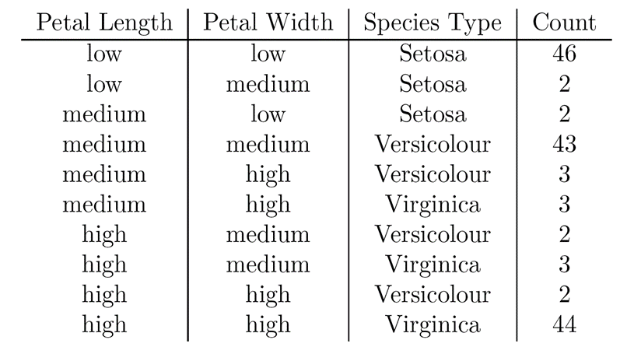
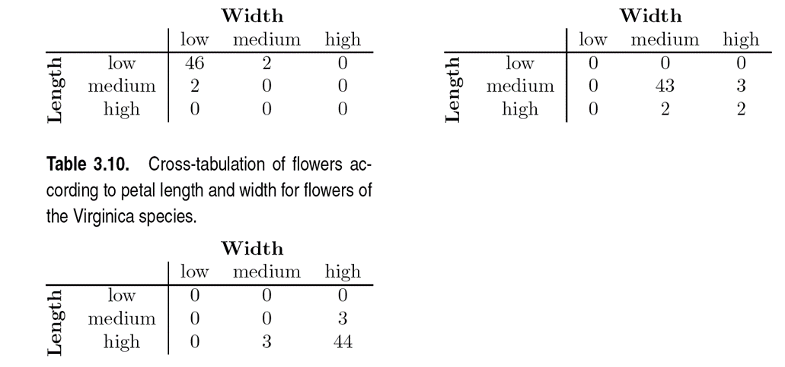
This element is assigned the corresponding count value. The figure illustrates the result.All non-specified ,tuples are 0.
Each unique tuple of petal width, petal length, and species type identifies one element of the array.

Slide 32
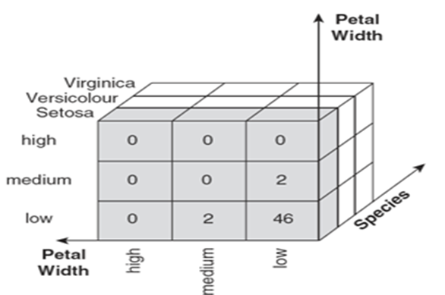

Slide 33
OLAP OPERATIONS: OLAP provides a user-friendly environment for interactive data analysis. Since OLAP servers are based on multidimensional view of data, we will discuss OLAP operations in multidimensional data.
OLAP operations: Roll-up or Drill up
Roll down or Drill-down
Slice and dice
Pivot (rotate)
Roll-up (DRILL UP): Roll-up performs aggregation on a data cube in any of the following ways and summarizing the data.
ROLL DOWN(Drill-down): Drill-down is the reverse operation of roll-up. It is performed by either of the following ways:
The following diagram illustrates how drill-down works:
Drill-down is performed by stepping down a concept hierarchy for the dimension time.
When drill-down is performed, one or more dimensions from the data cube are added.
It navigates the data from less detailed data to highly detailed data.
Slice & dice: Refers to the ability to look at the data from different viewpoints

Slide 34
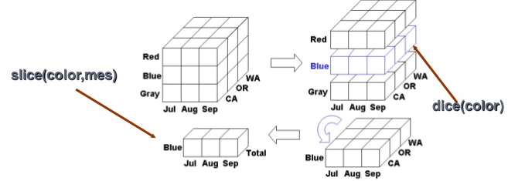

Slide 35
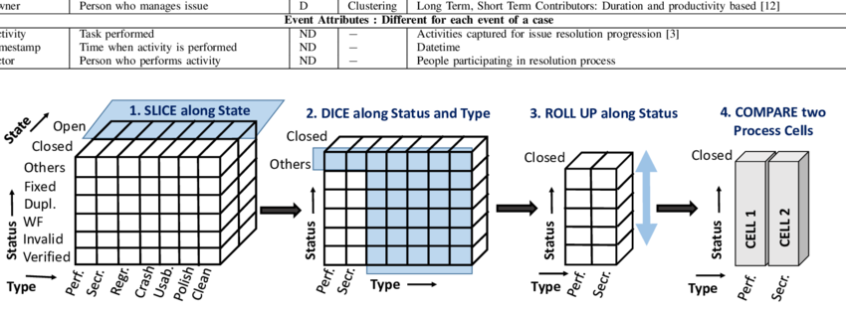

Slide 36
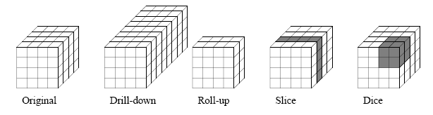

Slide 37
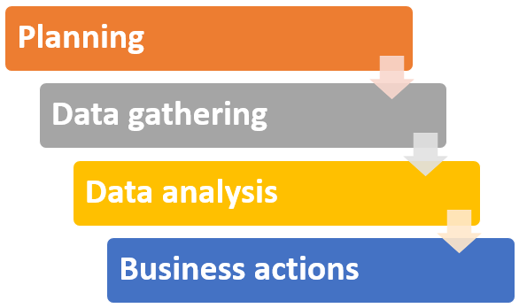
What is Data Warehouse Implementation?
The process of establishing and implementing a data warehouse system in an organization is known as data warehouse implementation. Data warehousing is one of the most important components of the business intelligence process for an organization. The data warehousing implementation process requires a series of steps that need to be followed in a very effective manner. The processes are as follows:

Slide 38
1. Planning
Planning is one of the most important steps of a process.It is the cornerstone of every successful project that is implemented in organizations. In case of the absence of sound planning, then there are high chances of failure of the project.
2. Data gathering
As data is available everywhere, but all the data available is not helpful for an organization. Data gathering is a process that involves the collection of data from various sources that can be used for data analysis and
3. Data analysis
Once the data is collected, the next step which comes into the picture is data analysis. The process of generating and getting meaningful insights out of the day together is known as data analysis.
4. Business actions
The insights and information attained from data analysis are further used for making decisions for the organization.

